Slide 1
Lab 4
Memory Management

Slide 2
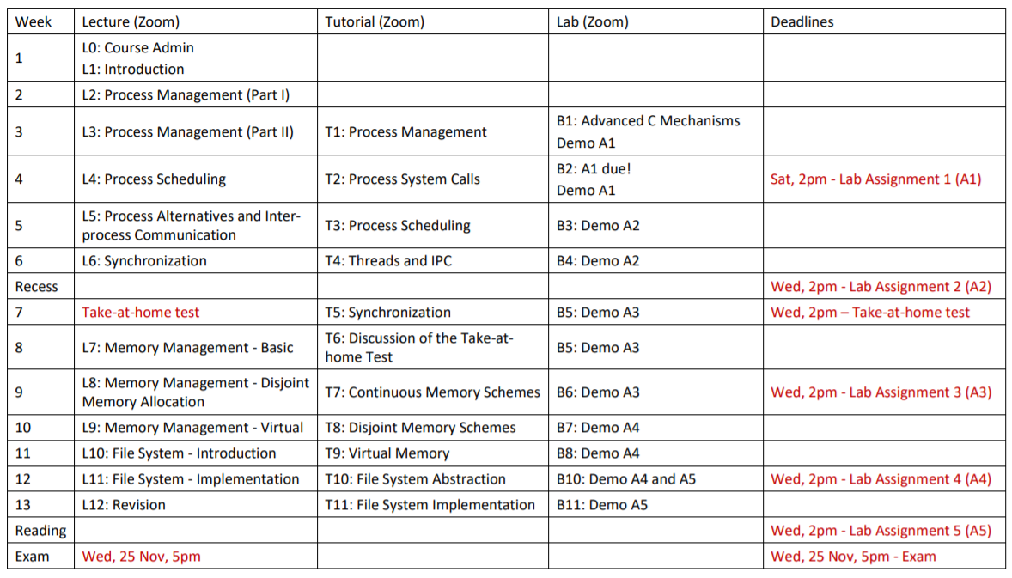
Tentative Schedule
Lab 4 deadline: 4th November

Slide 3
Exercise 0 (1%)
Implement memory-mapped files
Map a file to a physical memory region that can be shared with two processes.
Implement create_or_open and close functions
Useful commands:
open
close
ftruncate (resize a file)
mmap (map a file to somewhere)
munmap (remove the mapping of a file)

Slide 4
Exercise 1 (2%) (1a)
Implement initialisation and destruction of a shared heap
The technique we use in the exercise 0 is not efficient
Instead of using an actual file to share data, it is better to use the main memory.
Create a data structure in the .h file
Implement create, connect, disconnect, destroy and allocate functions
Create
Do like what you do in the exercise 0!
Connect
Similar to the create function. mremap might be used to change the size of the shared memory.
Disconnect
Similar to the close function in the exercise 0 (munmap)
Destroy
Disconnect + unlink the name
Allocate
For this exercise, this is called only once. You can just return a pointer pointing to the allocated region.

Slide 5
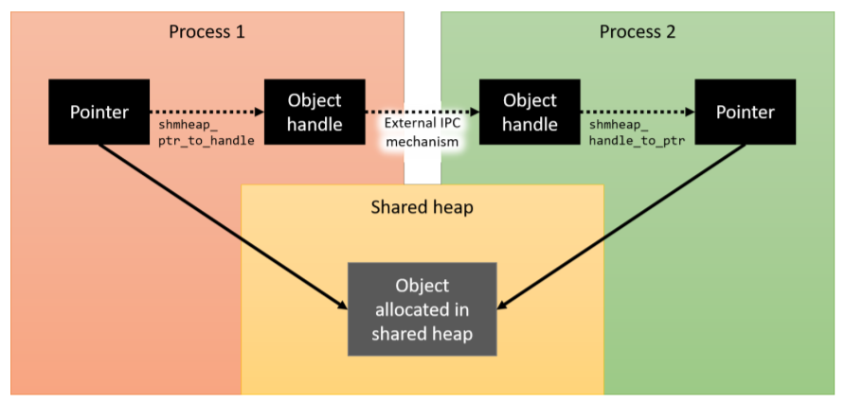
Exercise 1 (2%) (1b)
Implement ptr_to_handle and handle_to_ptr functions
Main idea: 2 processes have different “virtual” addresses that point to the same object
ptr_to_handle: Remove the virtual part (starting point), send the offset of the pointer
handle_to_ptr: Add this offset with the virtual part (starting point) to reproduce the pointer
Already implemented

Slide 6
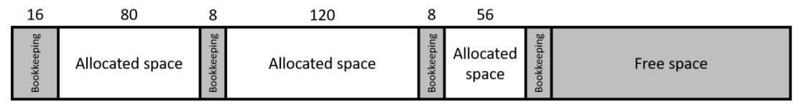
Exercise 2 (3%)
Implement the first-fit allocation algorithm (allocate & free)
Search the first free space that fits (is equal or bigger than the size of) the new block
Need to make the shared memory able to allocate more than one time
Your .h file + create function might need to be changed to be able to support this algorithm
Might need 2 data structures
One for the entire shared area
Another for each allocated space
Make sure that you manage + access the bookkeeping part properly

Slide 7
Exercise 3 (1%)
The former exercises assume that synchronisation is done properly
Implement a synchronisation mechanism for the allocate and free functions
Make sure that the allocate and free functions are atomic
A mutex can help

Slide 8
Demo Time!
Lab 4: Run ./main 4096

